Slide 1
Renato Freitas
UFC Fights Data Analysis

Slide 2
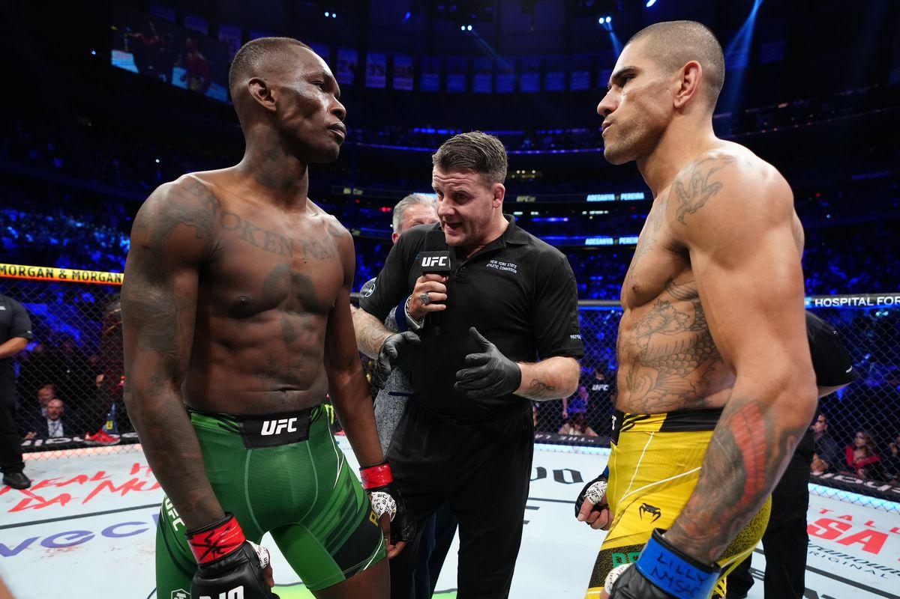
Introduction
What is the most likely finish method?
In which round is most likely to happen a Ko/TKO or Submission?
Does it matter if it is a Title Bout fight?
Betting hints
Source: https://www.kaggle.com/datasets/maksbasher/ufc-complete-dataset-all-events-1996-2024

Slide 3
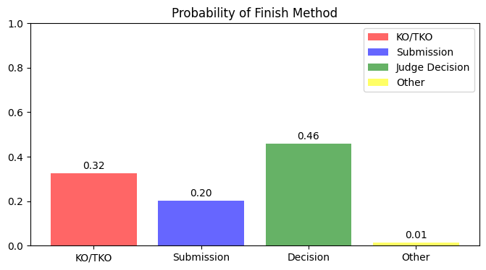
What is the most likely finish method?

Slide 4
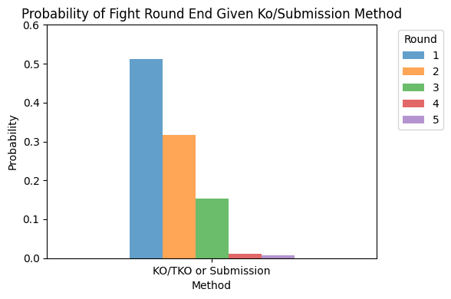
In which round is most likely to happen a KO/TKO or Submission?

Slide 5
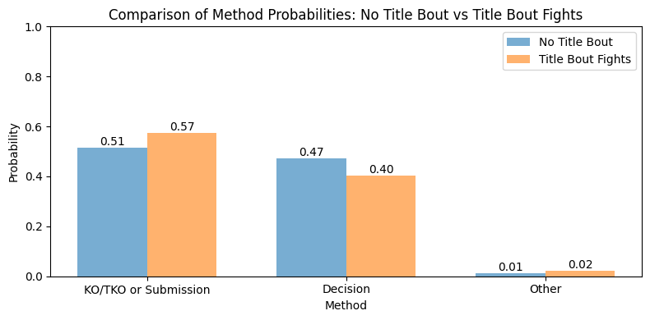
Does it matter if it is a Title Bout Fight?

Slide 6
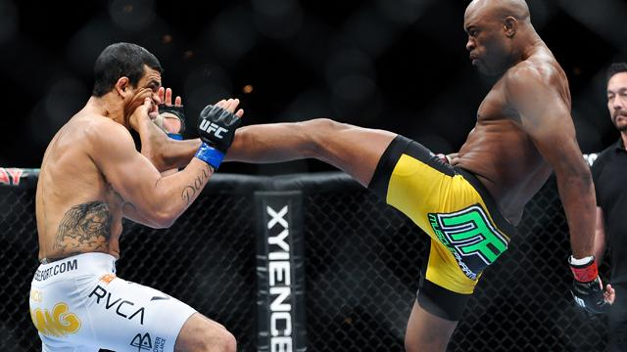

Betting Suggestion
Based on the previous analysis, I would suggest betting in a double chance finish method of KO/TKO or Submission in the first 2 rounds of a Title Bout Fight.

Slide 7
Thank you!

